Slide 1
Summary Report for BFX–UA300
Quality Issue on Jun-2022 Product
Prepared by: Rachel Ruan
Reviewed by: Toney Tu
Approved by: CB Lin
Date: 2022-Aug-24

Slide 2
Issue Description
On 2022-Jul-07, ALT customer complain that BFX-UA300 inspection fail of MP delivered on Jun-2022.
Overall inspection result:
Failed.
  Cancel Sampling Inspection
  Apply full (4000pcs) inspection
This inspection result is impacted ALT quality level.
Defect Total:
• Critical
  No boot 2pcs
  No Ethernet 1pcs
  Ethernet unstable 1pcs
• Major
  HDMI cable defect 5pcs

Slide 3
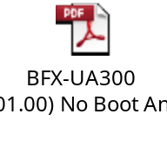
1.1. No boot
Issue Description | Root cause | Actions | Status
Symptom: No boot. Defect Q’ty : 1/1,088pcs Defect rate : 0.09% SKB SN: 2149695001202201009341 | The pin of R2994 is height to short with the heatsink (24V to 0V), caused the boot up fail. Fii verified 1 product, which one pin of R2994 short with the heat sink --> Product can not boot up and no console log. ➔The same as the DOA sample. | Action for Occur: Change the component leg length from 3.2±0.4 mm to 3.2±0.1 mm after cutting and update the cutting SOP. (IE: Haily, Done) Using fixture to check the Pin length, and update the SOP to add OK and NG pictures. (IE: Haily, Done) Train PTH VI to check the pins of R2994. (PD: Wen-yong, Done) Action for Escape: Fii plan to implement the Run in test (2 hours, 10 power cycles, power on 12 minutes, power off 30s). Waiting for customer green light. Due date: Aug-2022. OBA test implement the power on/off 3 times. | Monitor

Slide 4
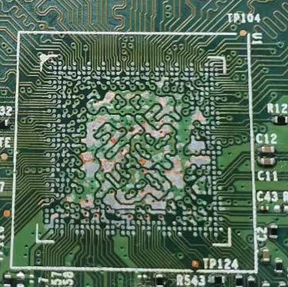

1.2. No boot
Issue Description | Root cause | Actions | Status
Symptom: No boot. Defect Q’ty : 1/1,088pcs Defect rate : 0.09% SKB SN: 2149695001202201011465 | When SWAP the new BGA & eMMC progress, it caused the pad peeling in U1 location due to improper operation. → Can’t further analyze anymore. Suspect this issue relate to Soc_U1. (IC PER, vendor: SYNAPTICS) PN:002.03237.005TL DC:D2110 | Action for Occur: Please ALT sent more NG sample for analysis. We will arrange to take Xray 100% for U1&U801 location. Action for Escape: Fii plan to implement the Run in test (2 hours, 10 power cycles, power on 12 minutes, power off 30s). Waiting for customer green light. Due date: Aug-2022. OBA test implement the power on/off 3 times. | Monitor

Slide 5

2. No Ethernet
Issue Description | Root cause | Actions | Status
Symptom: Ethernet does not work Defect Q’ty : 1/1,088pcs Defect rate : 0.09% SKB SN: 2149695001202201009369 | Removed & remounted the BGA U1, the product function pass. ➔Suspect BGA U1 (IC PER, vendor: SYNAPTICS) soldering issue. PN:002.03237.005TL DC:D2110 Fii performed the vibration test 2 cartons. Then power On test 2 hours. Result test: No abnormal issue. Fii performed the strain gauge test for PCBA assembly / testing station, no strain gauge risk issue found. Due to the failure symptom disappeared, Fii can’t find out the root cause. | Action for Occur: Please ALT sent more NG sample for analysis. We will arrange to take Xray 100% for U1&U801 location. Action for Escape: Fii plan to implement the Run in test (2 hours, 10 power cycles, power on 12 minutes, power off 30s). Waiting for customer green light. Due date: Aug-2022. | Monitor

Slide 6


3. Ethernet unstable
Issue Description | Root cause | Actions | Status
Symptom: Ethernet unstable Defect Q’ty : 1/1088pcs Defect rate : 0.09% SKB SN: 2149695001202201008099 | Root Cause for Occur: After SWAP verified, the defect (CRC NG) follow Ethernet PHY IC U801. (P/N: 002.02152.005, Vender: Realtek, D/C: DL50) Realtek tested the function of the IC, it showed NTF. Fii RD re-confirmed the IC defect with CRC NG. Realtek suspected this Ethernet PHY IC (U801) has compatibility issue SoC IC (U1). Fii SW RD adjust the SoC side Ethernet RX delay, it can improve the CRC issue. ➔The compatibility issue between SoC IC (U1) and Ethernet PHY IC U801. Root Cause for Escape: PT station CRC test item can cover this issue, but the test program of PT station bypass CRC. | Action for Occur: Fii SW RD try the Ethernet RX delay parameter to find the best solution. It need more data to study the parameter, suggest to collect the data during the production. Action for Escape: PT station implemented the CRC test. (Done) | Ongoing

Slide 7
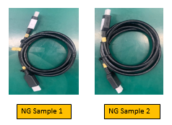
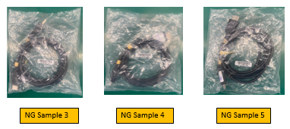


4. HDMI cable defect
Issue Description | Root cause | Actions | Status
Symptom: HDMI cable defect Defect Q’ty : 5 pcs D/C: 220421 & 220413 | FIT HDMI cable material issue. The pin copper wire of HDMI cable is broken & pin copper wire is not placed properly and is not placed in the corresponding pin slot. | Short term action: FIT 100% sorting the HDMI cable, sorted 35,242pcs, no defect found. (Done on Aug-17) Stock D/C: 220615, 220624, 220708, 220715 (FIT received 5pcs defect HDMI cables at May, and the improved D/C from 220601, so no defect found after sorting). Fii changed the HDMI cable of 1,080 FG units with sorted HDMI cable. ( Done on Aug-10) Long term action: FIT improved the HDMI cable from D/C 08.2022. | Close

